Slide 1
Parish Name Here
Presenter
Program announcements
Notes:
Pertinent information, please customize

Slide 2
Freedom to Choose
Notes:
Say: Welcome Domestic Church! Yes that’s correct. Each and every one of your homes is a Domestic Church. Our session together are designed to help you all grow in faith and live your lives as Catholics. Today’s session, Unit 5 Morality, will introduce you to this unit’s theme using the same process that is presented in your child’s Alive in Christ Book: Invite-Discover-Live (three-step catechetical process) Starting with an invitation into God’s Word, we will then discover what the Catholic Church teaches about Morality so we can Live a life that reflects our faith. In today’s session you will experience an example of each of the three steps.
This information will serve as a briefing for you as you work with your children to explore how we live this faith in everyday life. (Remember that there are 3 Chapters in each Unit)

Slide 3
Unit 5 Morality
In this unit we will discover that:
God always wants to be close to us
The Ten Commandments are laws from God to help us have right relationship with him and with others.
The first three Commandments order our relationship with God.
The next seven order our relationships with others.
Notes:
Read slide:
In this unit we will discover that:
God always wants to be close to us
The Ten Commandments are laws from God to help us have right relationship with him and with others.
The first three Commandments order our relationship with God.
The next seven order our relationships with others.

Slide 4
Unit 5 Morality
And that:
We write Jesus’ Great Commandment on our hearts.
We learn about forgiveness, examination of conscience, and the Sacrament of Reconciliation.
This unit also explains sin, virtue, obedience and disobedience, peace and justice, and serving others.
Notes:
Read slide:
And that:
We write Jesus’ Great Commandment on our hearts.
We learn about forgiveness, examination of conscience, and the Sacrament of Reconciliation.
This unit also explains sin, virtue, obedience and disobedience, peace and justice, and serving others.

Slide 5
Invite
We are now going to experience a different kind of praying. It is actually an ancient form of praying called Lectio Divina
(Latin for divine reading)
Notes:
Each time we gather for a session, we will begin by reflecting on God’s Word.
In every chapter you and your children will begin each lesson this way. (INVITE page)They will hear the Word of God, reflect on it, and open their hearts and minds to how God is speaking to them in this reading of Scripture. This reflection process is based on an ancient form of prayer called Lectio Divina. (Latin for divine reading) In it we read/hear the Word of God, listen carefully, and reflect on what God is saying to us.
(Use the picture on the next slide to talk a little bit about the prayer space, discussing the idea of having a family prayer space at home.)

Slide 6
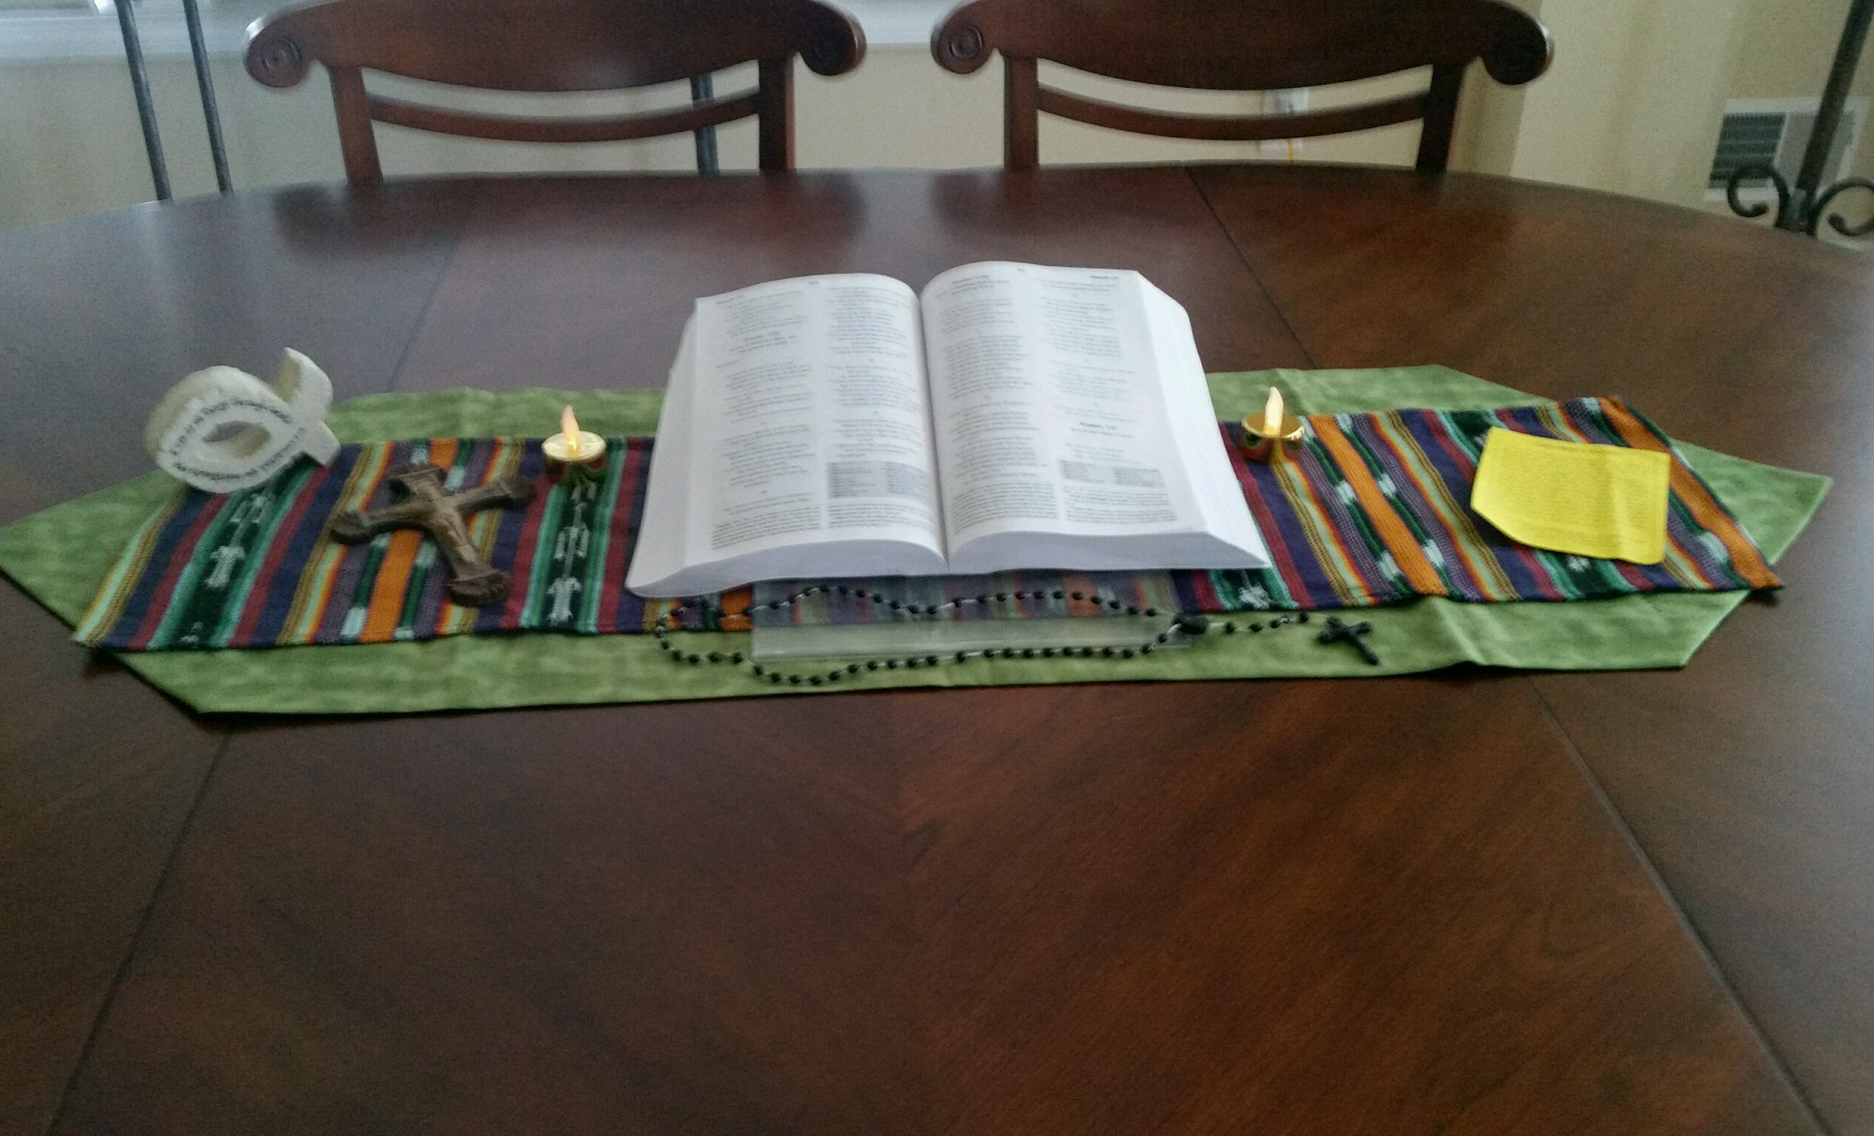
Notes:
Teach families what it means to venerate and why we venerate the Bible. (regard with great respect; revere. )
Suggest to families that in order to keep prayer at the center of what you do in these sessions, you must keep it at the center of your own life.

Slide 7
Encountering God in His Word
I invite you to close your eyes, or to just be still; open your minds and your hearts to
what God is saying to you in this passage.
Listen for: what speaks to you? What one
word or phrase stands out? Why might God be offering that word or phrase to you?
Notes:
SAY: I invite you to settle in your chair, take a few deep breathes, close your eyes, or to just be still; open your minds and your hearts to what God is saying to you in this passage. Before proclaiming the passage, pause for 5 seconds or so.

Slide 8
Luke 15: 11-32 The Prodigal Son
¹¹ Then Jesus said, “There was a man who had two sons. ¹² The younger of them said to his father, ‘Father, give me the share of the property that will belong to me.’ So he divided his property between them. ¹³ A few days later the younger son gathered all he had and traveled to a distant country, and there he squandered his property in dissolute living.
Notes:
SAY: I invite you to settle in your chair, take a few deep breathes, close your eyes, or to just be still; open your minds and your hearts to what God is saying to you in this passage. Before proclaiming the passage, pause for 5 seconds or so.
Proclaim the excerpt from Luke 15:11-32

Slide 9
¹⁴ When he had spent everything, a severe famine took place throughout that country, and he began to be in need. ¹⁵ So he went and hired himself out to one of the citizens of that country, who sent him to his fields to feed the pigs. ¹⁶ He would gladly have filled himself with the pods that the pigs were eating; and no one gave him anything. ¹⁷ But when he came to himself he said, ‘How many of my father’s hired hands have bread enough and to spare, but here I am dying of hunger!
Notes:
Proclaim scripture

Slide 10
¹⁸ I will get up and go to my father, and I will say to him, “Father, I have sinned against heaven and before you; ¹⁹ I am no longer worthy to be called your son; treat me like one of your hired hands.”’ ²⁰ So he set off and went to his father. But while he was still far off, his father saw him and was filled with compassion; he ran and put his arms around him and kissed him. ²¹ Then the son said to him, ‘Father, I have sinned against heaven and before you; I am no longer worthy to be called your son.’²²
Notes:
Proclaim scripture

Slide 11
But the father said to his slaves, ‘Quickly, bring out a robe—the best one—and put it on him; put a ring on his finger and sandals on his feet. ²³ And get the fatted calf and kill it, and let us eat and celebrate; ²⁴ for this son of mine was dead and is alive again; he was lost and is found!’ And they began to celebrate. ²⁵ “Now his elder son was in the field; and when he came and approached the house, he heard music and dancing.
Notes:
Proclaim scripture

Slide 12
²⁶ He called one of the slaves and asked what was going on. ²⁷ He replied, ‘Your brother has come, and your father has killed the fatted calf, because he has got him back safe and sound.’ ²⁸ Then he became angry and refused to go in. His father came out and began to plead with him. ²⁹ But he answered his father, ‘Listen! For all these years I have been working like a slave for you, and I have never disobeyed your command; yet you have never given me even a young goat so that I might celebrate with my friends.
Notes:
Proclaim scripture

Slide 13
³⁰ But when this son of yours came back, who has devoured your property with prostitutes, you killed the fatted calf for him!’ ³¹ Then the father said to him, ‘Son, you are always with me, and all that is mine is yours. ³² But we had to celebrate and rejoice, because this brother of yours was dead and has come to life; he was lost and has been found.’”
[NRSV-Catholic Edition]
Notes:
Proclaim scripture
After the reading pause for a few moments for silent reflection.
Model this for the group.

Slide 14
Encountering God in His Word
What word or phrase stood out to you?
Why might this have meaning?
Notes:
Break the silence by reading the questions on the slide.
Invite families to take a moment to think and discuss the questions and then write down the word or phrase in their Family + Faith Journal (at this point go back to the scripture slide so participants can see the reading again).
Ask for a volunteer or two to share why that word or phrase has meaning to them. In case there are no volunteers, be prepared with your own word or phrase so you can model the process for the group.

Slide 15
Encountering God in His Word
God always speaks to us. We will hear him if we make the space for him,
we seek him and intentionally listen for him.
Practice this type of prayer at home. Children are generally very open to listening for God in his Word.
Notes:
SUGGESTIONS:
Encourage families to create their own prayer center at home.
On a table drape fabric (if possible, keep with the colors of the liturgical cycle) across the table. Put a Bible on a bookstand in a place of prominence. Adorn the table with candles, and a cross or crucifix… simple and elegant. Possibly create a list of family prayer intentions.
Also, this can be a fruitful family practice each weekend. Prior to Mass (maybe Sat. evening), use this process and pray with this Sunday’s readings. This can make the Liturgy of the Word more meaningful for all members of the family.
Now, transition to the Discover Step.

Slide 16
The Discover Step helps form Catholic Identity through the study of Scripture, knowledge of Church teaching, and an understanding of Catholic practices. It presents the doctrine of the lesson in developmentally appropriate language and images.
Notes:
Read the slide:
The Discover Step helps form Catholic Identity through the study of Scripture, knowledge of Church teaching, and an understanding of Catholic practices. It presents the doctrine of the lesson in developmentally appropriate language and images.

Slide 17
Jesus said, “…I came so that they might have life and have it more abundantly” (John 10:10) [NRSV-CE]
Today, we focus on Morality. Some people hear the word “morality” and get a little uncomfortable.
They think it’s a list of “don’ts.”
Notes:
Read slide:
Jesus said, “I came so that they might have life and have it more abundantly” (John 10:10). Today, we focus on Morality. Some people hear the word “morality” and get a little uncomfortable.
They think it’s a list of “don’ts.”

Slide 18
Morality is really about right relationships,
our relationship with God and with others.
It isn’t about “no.”
It’s about
saying
to God’s will for us.
YES
YES
Notes:
Read slide:
But Morality is really about right relationships, our relationship with God and with others. It isn’t about “no.”
It’s about “yes”—saying “yes” to God’s will for us.

Slide 19
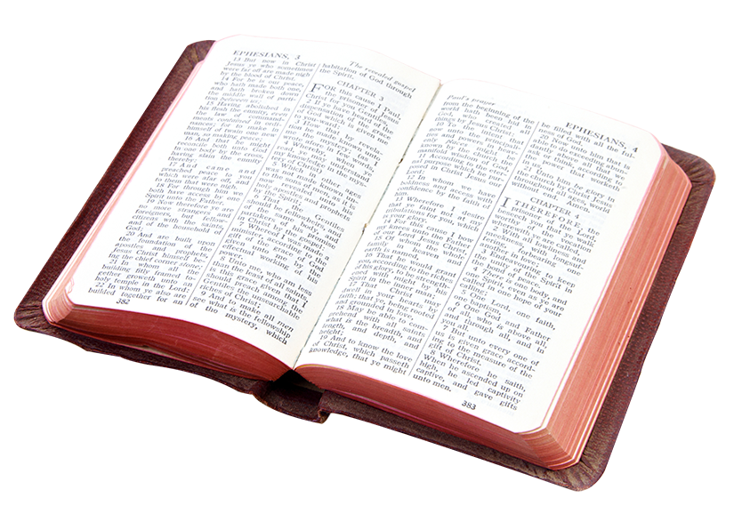
Scripture tells us about God’s will for us in his Commandments found in both the Old and New Testaments.
In the Old Testament, we can read these Commandments in Deuteronomy and the Book of Psalms.
Notes:
Read slide:
Scripture tells us about God’s will for us in his Commandments found in both the Old and New Testaments.
In the Old Testament, we can read these Commandments in Deuteronomy and the Book of Psalms.

Slide 20
Deuteronomy 6:4-7
4 Hear, O Israel: The Lord is our God, the Lord alone. 5 You shall love the Lord your God with all your heart, and with all your soul, and with all your might. 6 Keep these words that I am commanding you today in your heart. 7 Recite them to your children and talk about them when you are at home and when you are away, when you lie down and when you rise. [NRSV-Catholic Edition]
Notes:
Read slide: Deuteronomy 6:4-7
4 Hear, O Israel: The Lord is our God, the Lord alone. 5 You shall love the Lord your God with all your heart, and with all your soul, and with all your might. 6 Keep these words that I am commanding you today in your heart. 7 Recite them to your children and talk about them when you are at home and when you are away, when you lie down and when you rise.

Slide 21
Psalm 119: 32-35 The Glories of God’s Law
³² I run the way of your commandments, for you enlarge my understanding.
³³ Teach me, O Lord, the way of your statutes, and I will observe it to the end. ³⁴ Give me understanding, that I may keep your law and observe it with my whole heart. ³⁵ Lead me in the path of your commandments, for I delight in it. [NRSV-Catholic Edition]
Notes:
Read slide:
Psalm 119: 32-35 The Glories of God’s Law
³² I run the way of your commandments, for you enlarge my understanding.
³³ Teach me, O Lord, the way of your statutes, and I will observe it to the end. ³⁴ Give me understanding, that I may keep your law and observe it with my whole heart. ³⁵ Lead me in the path of your commandments, for I delight in it.

Slide 22
And in the New Testament, we can read about God’s will for us in the Gospel according to John.
Notes:
Read slide:
And in the New Testament, we can read about God’s will for us in the Gospel according to John.

Slide 23
John 15:10-11.
¹⁰ If you keep my commandments, you will abide in my love, just as I have kept my Father’s commandments and abide in his love. ¹¹ I have said these things to you so that my joy may be in you, and that your joy may be complete.
[NRSV-Catholic Edition]
Notes:
Read slide: John 15:10-11.
¹⁰ If you keep my commandments, you will abide in my love, just as I have kept my Father’s commandments and abide in his love. ¹¹ I have said these things to you so that my joy may be in you, and that your joy may be complete.

Slide 24
The Great Commandment
“You shall love the Lord your God with all your heart, and with all your soul, and with all your strength, and with all your mind; and your neighbor as yourself.” Luke 10:27
[NRSV-Catholic Edition]
Notes:
Read slide:
The Great Commandment
“You shall love the Lord your God with all your heart, and with all your soul, and with all your strength, and with all your mind; and your neighbor as yourself.” Luke 10:27

Slide 25
We know these Commandments are important to God.
These laws help us live in right relationship with him and others.
Notes:
Read slide:
We know these Commandments are important to God.
These laws help us live in right relationship with him and others.

Slide 26
With the Ten Commandments God gave us the formula to be in right relationship with God and our neighbors.
Notes:
Read slide:
With the Ten Commandments God gave us the formula to be in right relationship with God and our neighbors.

Slide 27
The first three Commandments order our relationship with God
I am the Lord your God; you shall not have strange gods before me.
You shall not take the name of the Lord your God in vain.
Remember to keep holy the Lord’s Day.
Notes:
Read slide:
The first three Commandments order our relationship with God
I am the Lord your God; you shall not have strange gods before me.
You shall not take the name of the Lord your God in vain.
Remember to keep holy the Lord’s Day.

Slide 28
The last seven order our relationships with others.
4. Honor your father and your mother.
5. You shall not kill.
6. You should not commit adultery.
7. You shall not steal.
8. You shall not bear false witness against your neighbor.
9. You shall not covet your neighbor’s wife.
10. You shall not covet your neighbor’s goods.
Notes:
Read slide : The last seven order our relationships with others.
4. Honor your father and your mother.
5. You shall not kill.
6. You should not commit adultery.
7. You shall not steal.
8. You shall not bear false witness against your neighbor.
9. You shall not covet your neighbor’s wife.
10. You shall not covet your neighbor’s goods.

Slide 29
Why are we instructed to write this law on our hearts?
How can this ancient law have anything to do with us today?
How is this Commandment relevant in our lives today?
Notes:
Read slide then ask families to choose one of the commandments and have a discussion using the questions on the slide. Ask them to write their answer in their Family + Faith Journal.
Ask for one family to share their answer for each of the questions.

Slide 30
Be sure to review the three Unit 5 Morality chapters with your child. Depending on the Grade Level, the children will discover these important Church teachings:
The Ten Commandments
Jesus’ Great Commandment
The Beatitudes
The Precepts of the Church
(continued next slide)

Slide 31
Some levels will learn about forgiveness, examination of conscience, and the Sacrament of Reconciliation.
Some levels will learn about building relationships in the family, in the community, in the world, and with God.
They will also learn about virtues, peace and justice, and serving others.
Notes:
Read slides then say:
In addition to your child’s Alive in Christ book’s 3 specific Unit 5: Morality lessons, be sure to reference the Our Catholic Tradition- We Live section found in the back of the book.

Slide 32
The Live Step helps us relate knowledge of the faith and ways we worship, live, pray, and serve together as Catholics.
We are given the tools to connect faith to everyday life and to deepen their relationship with God and the Church through the prayer experience at the end of each lesson.
Notes:
Read slide describing the Live Step and then say:
On the next slide there are a few samples of “Let’s Talk” from the Unit 5 Morality Family + Faith Parent Pages.
For the next few minutes choose 1 of the questions and have a family discussion.
When you receive your email with the Unit 5 Morality Family + Faith Parent Pages, please continue with this exercise.

Slide 33
Let’s Talk
• Ask your child to explain the Great Commandment.
• Ask your child to explain what Jesus taught about sin and forgiveness.
• Share a story of forgiveness in your own family.
• Together, name some ways to promote peace, fairness, and love in your family.
• Talk about a time when you’ve found it difficult to forgive. What did that experience teach you?
Notes:
Let’s Talk
Time permitting, ask if anyone would like to share a comment or question.

Slide 34
Family + Faith Parent Pages have been created so that families can review the topic, implement practices, in order to transform their lives.
Notes:
These pages will provide information and activities that will enable families to complete the Live step for Unit 5 Morality.

Slide 35
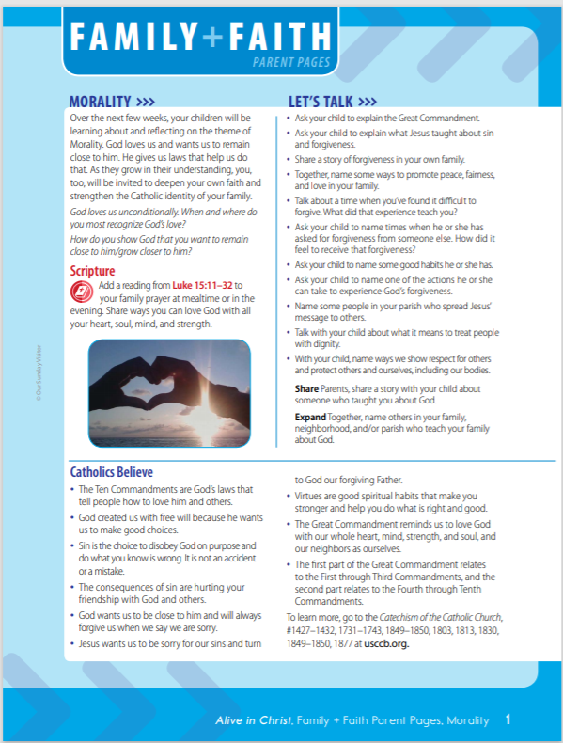
Topic Description
Conversation
Starters
Scripture
Proclaimed
What Catholics
Believe About
this Topic
Notes:
Review Key Features of the Family + Faith Parent Pages:
- Theme Description
- Scripture Proclaimed
- What Catholics Believe About the Theme
- Let’s Talk Conversation Starters

Slide 36
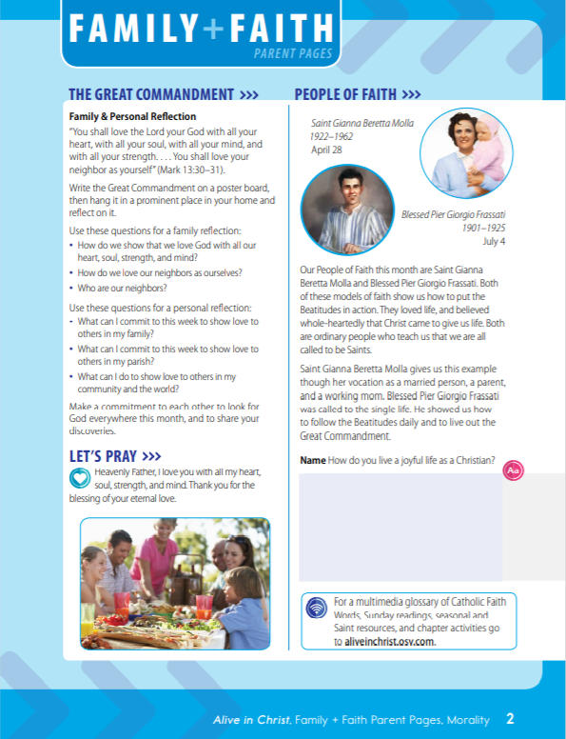
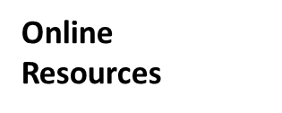
Family Activity
Role Models:
Saints, Blesseds & Venerables
Family Prayer
Notes:
Review Key Features of the Family + Faith Parent Page 2:
Family Activity
Family Prayer
People of Faith
Online Resources

Slide 37
Domestic Church
Parish Church
Notes:
Review Key Features of the Family + Faith Parent Page 3:
IN THE HOME AND THE COMMUNITY

Slide 38
Reminder
Be on the lookout for an email from [INSERT PROGRAM EMAIL ADDRESS]. This email will contain Family + Faith Parent Pages and eAssessment links for this Unit
Be sure to complete and submit eAssessments by [provide date]
Any other important information
Notes:
Read reminders and then say: As we close our Family + Faith Session we want to emphasize a few key points: 1. We feel privileged to accompany you and your families in this faith journey. You are the most important influence in the faith life of your children. We intend to assist you in this mission, and to offer ideas, resources, and experiences that will empower you in this mission.
2. Family+ Faith Sessions offer parents an opportunity to journey with and be supported by other parents.
3. It gives families a shared faith language and shared faith experiences, as we focus on the same themes, doctrinal lessons, as well as the prayers and practices of our faith.
4. It gives children the opportunity to see us “being Church” together, as parents join them at church for faith formation.

Slide 39
We’re emailing a copy of the Great Commandment along with your Parent Pages, reminding you to write this Commandment on your hearts. Keep the verse posted somewhere you will see it often this month—maybe on your refrigerator, at the kitchen table, or in your home prayer space. Discuss with each other how you will show your love for God, and what you can do to love others. Before we conclude with prayer, we’ll practice the Great Commandment with gestures.
Notes:
Lead families through the Great Commandment with gestures.

Slide 40
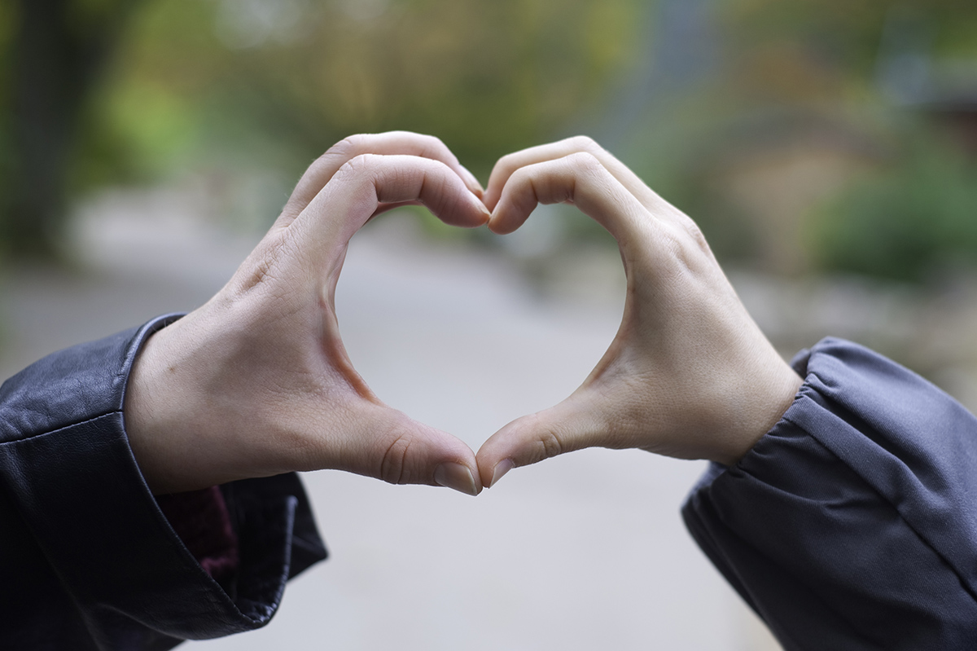
The Great Commandment with gestures
Say:
You shall love the Lord your God with all your heart
(Cup your hands together in front of you, making the outline of a heart.)
Notes:
O.K. together let us recite The Great Commandment with gestures.
Maybe we’ll do it twice to make sure we have the moves down.

Slide 41
The Great Commandment
with all your soul . . .
(Cross your arms over your chest.)

Slide 42
The Great Commandment
with all your mind . . .
(Touch the temple of your head with your fingertip.)

Slide 43
The Great Commandment
and with all your strength…
(Show us your muscles! Arms up—flex those biceps.)

Slide 44
The Great Commandment
You shall love your neighbor . . .
(Clasp your hands together in front of you, facing out.)

Slide 45
The Great Commandment
as yourself.
(Point to the center of your chest.)
Amen

Slide 46
Closing Prayer
We thank you, Lord, for giving us the opportunity to reflect upon the gift of your guidance,
the gift of your law,
the gift of your Son.
Help us to write your laws on our hearts, God.
Let us be open to your will, as we pray the words your Son
taught us.
Our Father, who art in heaven . . .

