Slide 1

Missionary Discipleship

Slide 2
Our Father, who art in Heaven,
hallowed be thy name.
Thy kingdom come,
thy will be done on earth as it is in Heaven.
Give us this day our daily bread,
And forgive us our trespasses
as we forgive those who trespass against us,
And lead us not into temptation,
but deliver us from evil.
Amen.

Slide 3
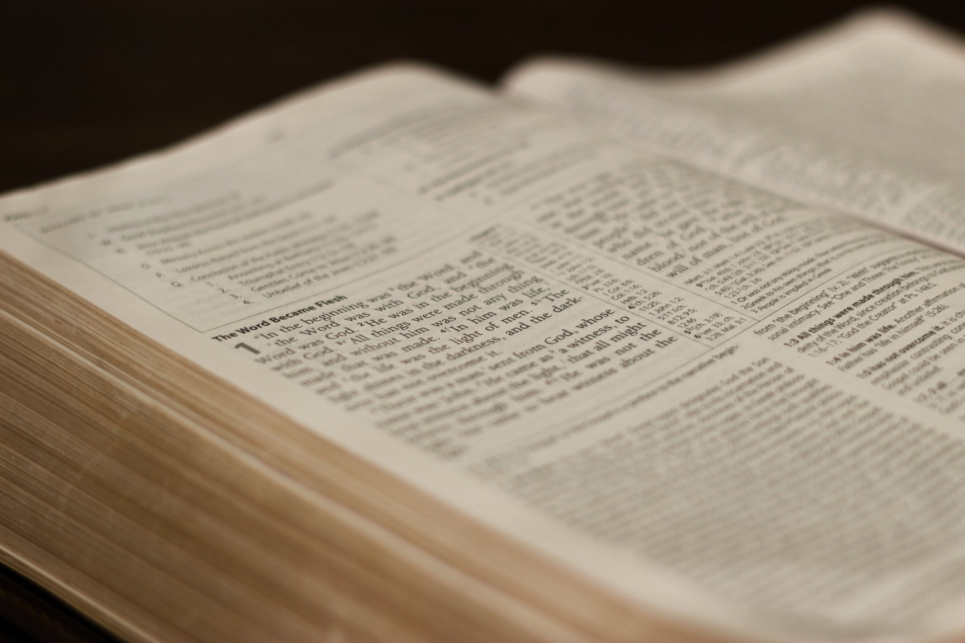
Luke 2: 41-52

Slide 4
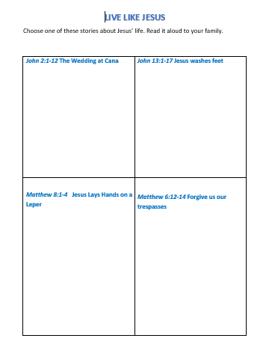

Slide 5
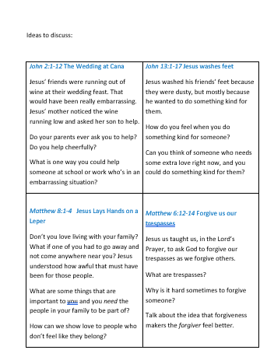

Slide 6
Why do you attend Mass, or why do you think Mass is important or beautiful?

Slide 7
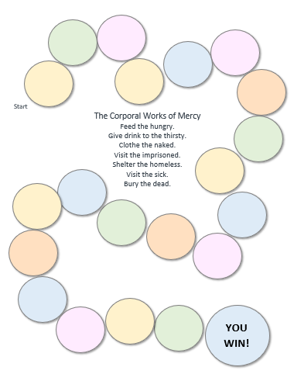
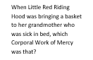
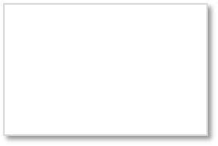
Corporal Works of Mercy
  Feed the hungry.
  Give drink to the thirsty.
  Clothe the naked.
  Visit the imprisoned.
  Shelter the homeless.
  Visit the sick.
  Bury the dead.

Slide 8
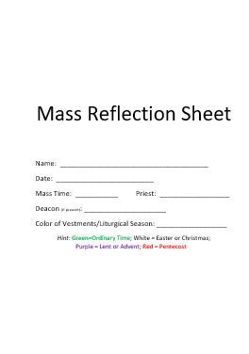

Slide 9
Finally, brothers, whatever is true,
whatever is honorable, whatever is just, whatever is pure, whatever is lovely, whatever is gracious,
if there is any excellence
and if there is anything worthy of praise, think about these things.
(Philippians 4:8, NABRE)

Slide 10
Leader: May we all go out to love and serve others as Jesus has loved and taught us.
All: Thanks be to God.

